Slide 1
Logic Gates
Discrete Structures

Slide 2
Gate
A device that performs a basic operation on
electrical signals.
Circuits
Gates combined to perform more
complicated tasks.

Slide 3
How do we describe the behavior of gates and circuits?
Boolean expressions
Uses Boolean algebra, a mathematical notation for expressing two-valued logic.
Logic diagrams
A graphical representation of a circuit; each gate has its
own symbol.
Truth tables
A table showing all possible input
value and the associated
output values.

Slide 4
GATES
Six types of gates
NOT
AND
OR
XOR
NAND
NOR
Typically, logic diagrams are black and white with gates distinguished only by their shape
We use color for emphasis (and fun).

Slide 5
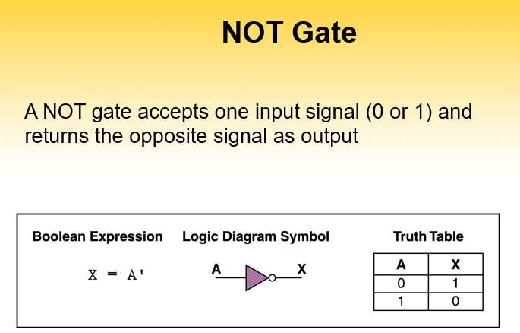

Slide 6
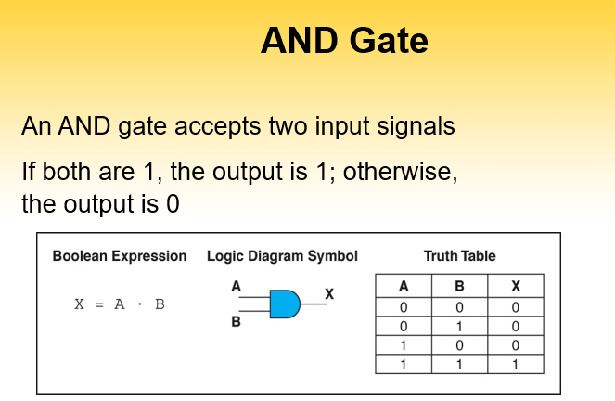

Slide 7
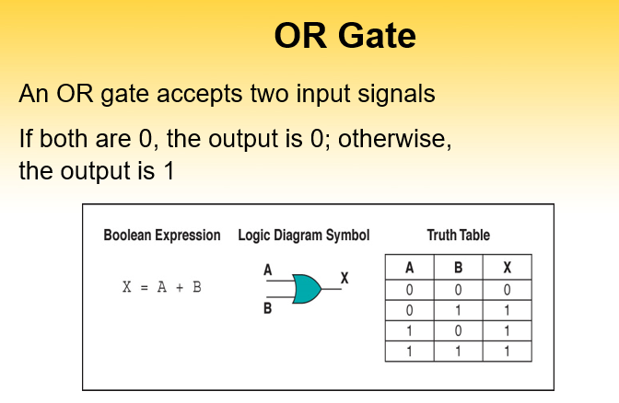

Slide 8
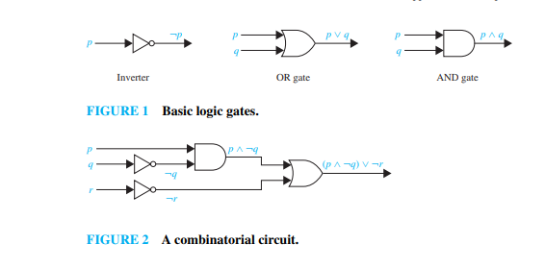

Slide 9
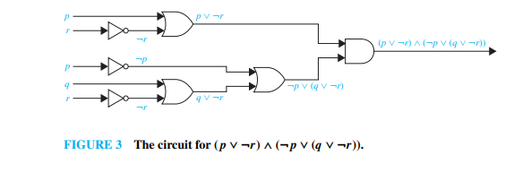

Slide 10
